Slide 1

CHAPTER 6 Artificial Intelligence, Machine Learning, and Cognitive Services in Azure
|LEARNING MICROSOFT AZURE

Slide 2
Understanding Artificial Intelligence
AI: Simulates human intelligence to automate decision-making and improve efficiency.
Gartner Definition: AI involves advanced analysis and logic, supporting and automating decisions.
Key languages and tools: Python, C#, R, Azure AI Services.

Slide 3
Azure OpenAI Service and GPT Evolution
Launched in 2023, providing access to models like GPT-3.5, GPT-4, Codex, and DALL-E 2.
Enterprise-grade AI models for building large-scale AI solutions.
Integration in tools like GitHub Copilot, Power BI, and Microsoft Designer.
Azure OpenAI service requires an application to use, ensuring responsible AI usage.

Slide 4
Key AI Innovations in Azure
Natural Language Processing (NLP): Used for chatbots, IVR systems, etc.
Internet of Things (IoT): AI applied in smart homes, healthcare, transportation.
Computer Vision (CV): Object recognition in self-driving cars, retail, and drones.
Synthetic Data: Generated to protect sensitive info and train AI models.
Edge AI: Deploy AI at the "edge," enabling real-time responses in devices.

Slide 5
Generative AI in Action
GenAI creates content (images, text, etc.) based on learned data without replication.
Used in fields like media creation, content generation, and virtual agents.
Example: Virtual health assistants (VHAs) in healthcare.

Slide 6
Starting with AI in Azure
Azure Cognitive Services: Pre-built APIs for language, vision, speech, and decision-making.
Azure Machine Learning: Build, train, and deploy ML models at scale.
AI Builder: No-code AI development for Power Apps and Power Automate.

Slide 7
The Future of AI in Azure
AI innovations will continue to grow in areas like healthcare, finance, and customer service.
Edge AI and IoT will enable faster, real-time processing.
Azure’s platform provides scalable, secure AI solutions for businesses.

Slide 8
What is Machine Learning?
ML is a subfield of AI focused on creating algorithms and models that learn from and make predictions based on data.
Core Concept: ML enables systems to learn from data patterns to improve prediction accuracy without being explicitly programmed.

Slide 9
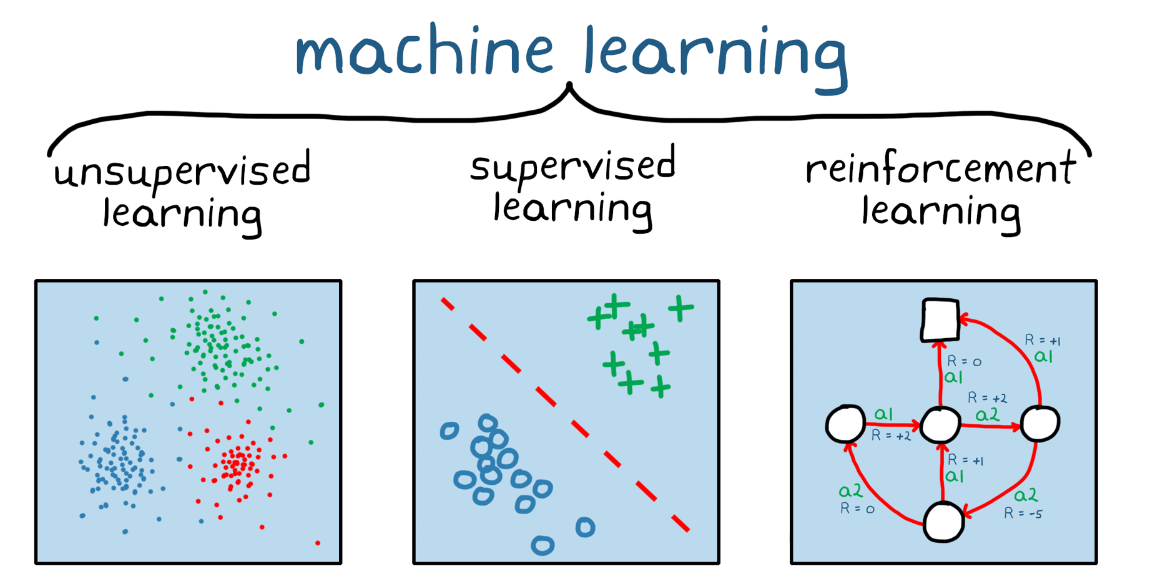
Categories of Machine Learning
Supervised Learning: Trained on labeled data with known outputs. Example: Predicting house prices.
Unsupervised Learning: Trained on unlabeled data to identify hidden patterns. Example: Customer segmentation.
Reinforcement Learning: Trained to make decisions based on rewards or penalties. Example: Game AI or self-driving cars.

Slide 10
What is MLOps?
Similar to DevOps, but for ML. MLOps automates the entire ML lifecycle from development to deployment.
Goal: Ensure scalability, reliability, and effective deployment of ML models.

Slide 11
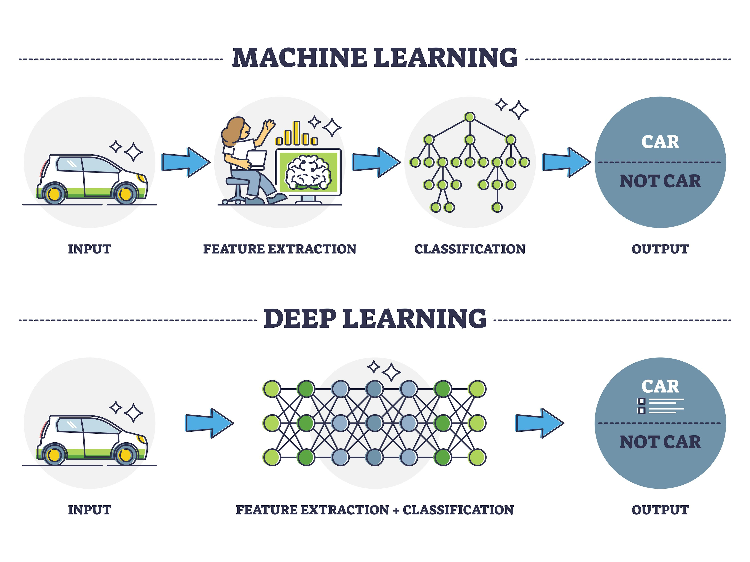
Deep Learning in ML
A subset of ML that uses artificial neural networks with multiple layers.
Key Applications: Autonomous vehicles, speech recognition, image classification, and medical diagnoses.

Slide 12
What is Ethical AI?
Ethical AI focuses on designing AI systems that are fair, transparent, and responsible.
Core Question: What should these systems be allowed to do?
Ethical AI ensures that AI technologies maintain human dignity and don’t harm society.

Slide 13
Responsible AI Practices on Azure
Microsoft developed Fairlearn, a toolkit to detect and mitigate fairness issues in AI models.
Key Focus Areas:
Fairness in data and algorithms.
Transparency and accountability.
Mitigation of biased decisions.

Slide 14
Introduction to Azure AI and Cognitive Services
Overview:
A suite of powerful APIs that enable developers to add intelligent features into their applications.
Key Features:
Pre-built APIs for vision, speech, language, and decision-making tasks.
No deep AI knowledge required to integrate.
Accessible via REST APIs, SDKs, and services that can run in the cloud or on edge devices.
Use Cases:
Add speech recognition to call centers.
Automate text analysis in document workflows.
Implement intelligent chatbots for customer service.

Slide 15
Key Benefits of Using Azure AI
Customizable pre-trained models: Leverage Microsoft’s AI research for faster development.
Supports hybrid cloud and edge scenarios: Run AI in the cloud or on local devices, providing flexibility and scalability.
Broad API support across industries: Tailored solutions for healthcare, retail, manufacturing, and more.
Security and Compliance: Built-in support for data governance, privacy, and regulatory compliance with Azure's trusted cloud infrastructure.

Slide 16
Cognitive Services Overview
Speech: Convert speech to text, translate languages, text-to-speech.
Vision: Analyze visual data and images, recognize objects, faces, and handwriting.
Language: NLP for extracting meaning from text, building conversational bots.
Decision: Build decision-making systems, detect anomalies in data, moderate content.
Examples:
Speech-to-text in real-time meetings.
Image tagging for e-commerce product catalogs.
Customer service chatbots using natural language understanding.

Slide 17
Speech Services
Key Features:
Speech-to-text for converting spoken language into text.
Text-to-speech for creating natural-sounding audio from text.
Speech translation across multiple languages.
Customization:
Train custom speech models to recognize industry-specific jargon (e.g., healthcare terms).
Adapt the service to regional accents and dialects.
Example:
Implement real-time captioning for accessibility during live events.
Use speech synthesis in automated phone systems.

Slide 18
Vision Services
Computer Vision:
Image recognition, object detection, and optical character recognition (OCR) for text extraction.
Custom vision to build your own image classification models.
Face API:
Detect and recognize human faces in images or video streams.
Features include emotion detection, age estimation, and face identification.
Use Case Example:
Inventory management with object detection and tagging.
Automated identity verification in banking apps using facial recognition.
How OCR extracts data from a scanned invoice.

Slide 19
Language Services
Natural Language Processing (NLP):
Text analytics for sentiment analysis, key phrase extraction, language detection, and entity recognition.
QnA Maker:
Build a question-and-answer system from structured data sources like FAQs.
LUIS (Language Understanding Intelligent Service):
Build custom models that understand intent and extract information from conversations.
Use Cases:
Build conversational AI for customer support chatbots.
Enhance document workflows by extracting key information from contracts or emails.
Deploy sentiment analysis to monitor social media feedback.

Slide 20
Decision Services
Anomaly Detector:
Detect irregular patterns in time-series data (e.g., detecting fraud in transaction data).
Content Moderator:
Automatically flag inappropriate or offensive content in images, text, and video.
Personalizer:
Deliver personalized recommendations by learning from user interactions.
Example:
Use anomaly detection in predictive maintenance for machinery.
Moderate user-generated content on a social platform.

Slide 21
Azure Machine Learning (ML) Overview
Comprehensive platform to manage the entire machine learning lifecycle: from data preparation to model deployment and monitoring.
Key Features:
Build, train, and deploy ML models at scale.
Support for popular frameworks (TensorFlow, PyTorch, scikit-learn).
Seamless integration with Azure DevOps and CI/CD pipelines for MLOps.
MLOps:
Automate and streamline the continuous training and deployment of models with Azure DevOps.
Use Case Example:
Real-time predictive analytics for fraud detection in financial transactions.
Customer segmentation and recommendation models for e-commerce.

Slide 22
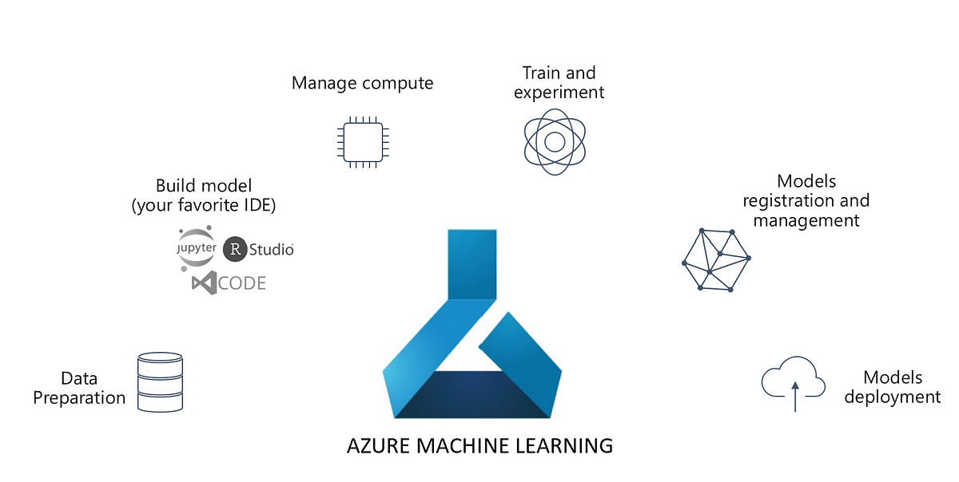
Azure ML Studio and AutoML
Azure ML Studio:
Web-based interface to develop, train, and deploy ML models using drag-and-drop workflows.
Supports both code-first and no-code experiences.
Automated ML (AutoML):
No-code machine learning where Azure automatically selects the best models and hyperparameters.
Ideal for business users or beginners in ML.
Use Case Example:
Rapidly prototype a customer churn prediction model using AutoML.

Slide 23
AI Builder for Power Platform
AI Builder: No-code AI solutions that integrate with Power Apps and Power Automate.
Key Features:
Pre-built models for tasks like form processing, object detection, and text recognition.
Easy deployment in business applications with drag-and-drop simplicity.
Use Case Example:
Automate document approval processes by extracting data from forms.
Build AI-powered mobile apps that recognize products in real-time for inventory management.

Slide 24
Applied AI Services
Form Recognizer: Extracts structured data from invoices, receipts, and business forms.
Azure Cognitive Search: Leverages AI to extract insights from all kinds of content (documents, images).
Azure Bot Service: Build intelligent chatbots that integrate with multiple communication channels.
Use Case Example:
Automate customer service with bots that answer common inquiries.
Streamline document processing workflows by extracting and indexing key data from forms.

